Slide 1

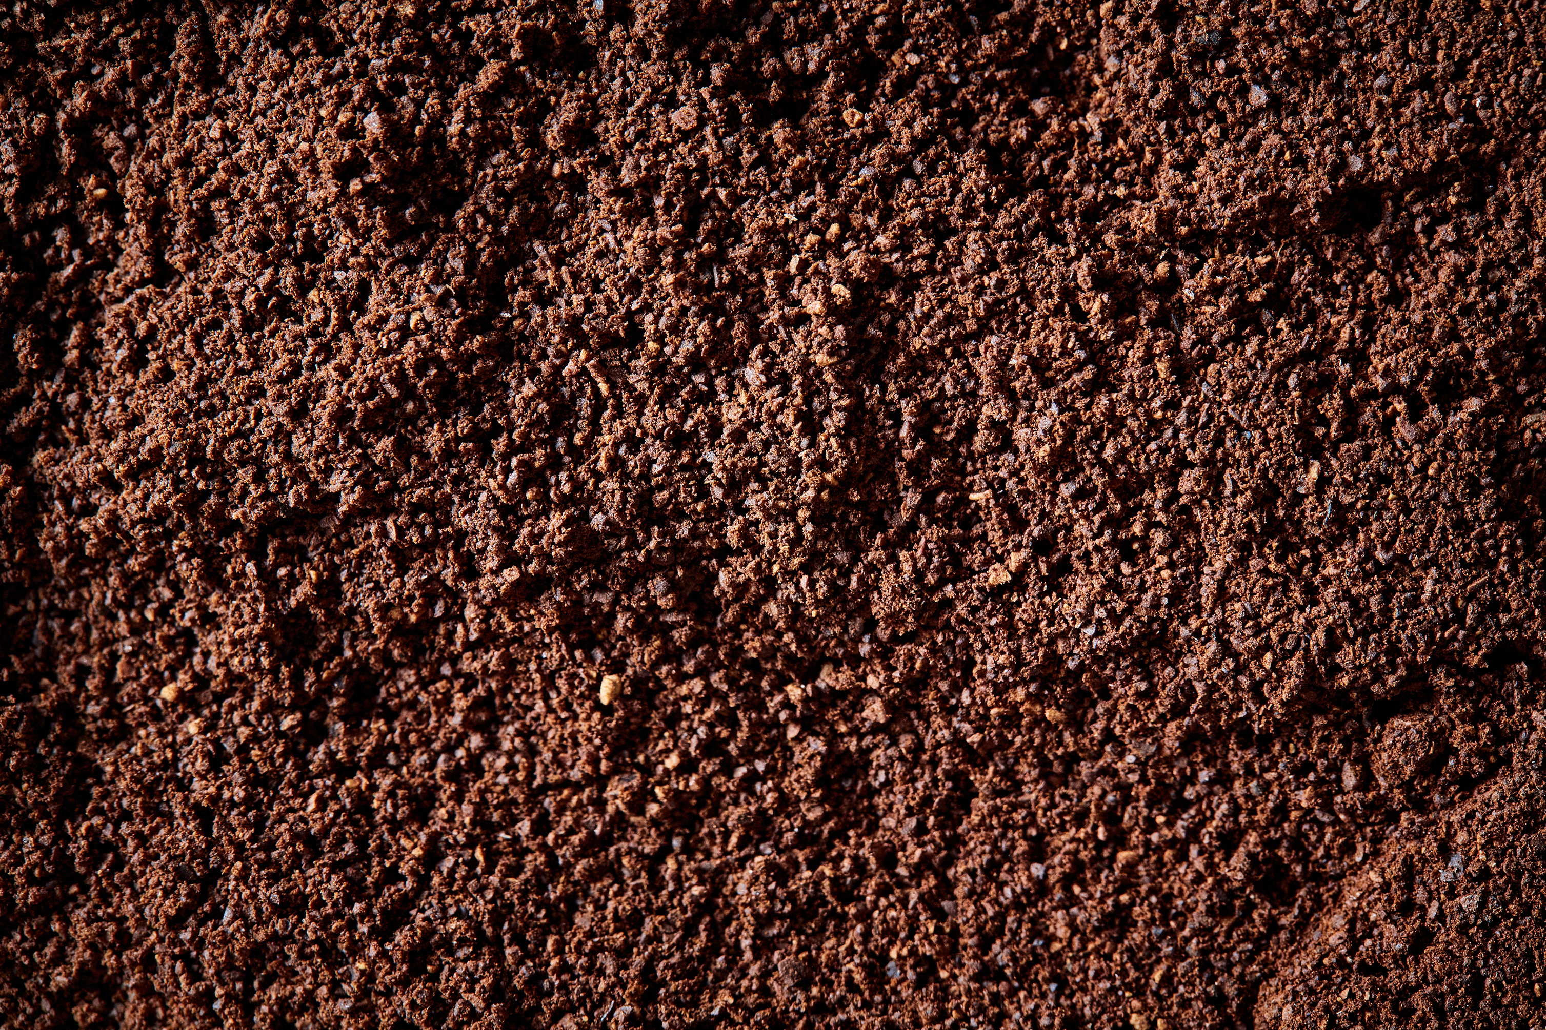
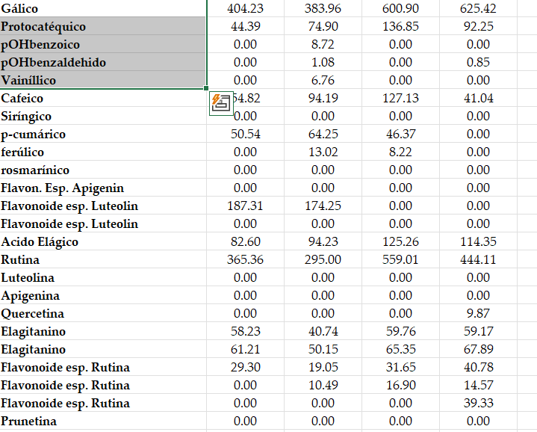
a) Batch partition and kinetics EPIC
CG-MS
VOCs
HPLC-DAD
PhCs

Slide 2
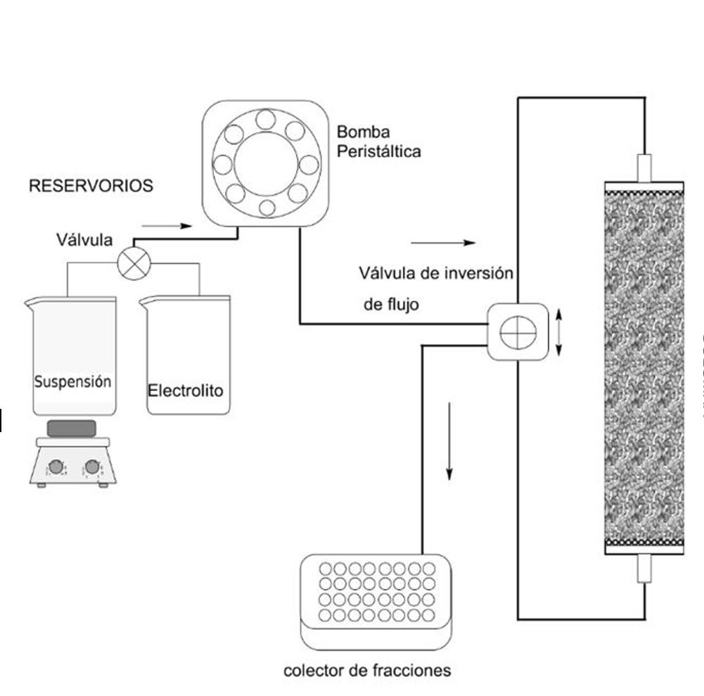
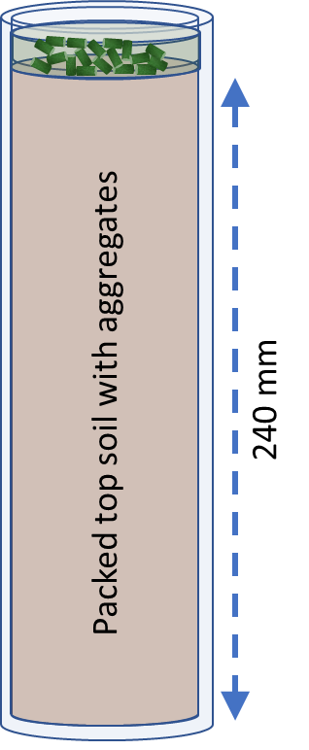
b) Preparation of the columns
c) Column diffusion-advection experiment
Reservoir ecoherbicide
250 mm
240 mm
PTFE tube
Packed top soil with aggregates
40 mm

Slide 3
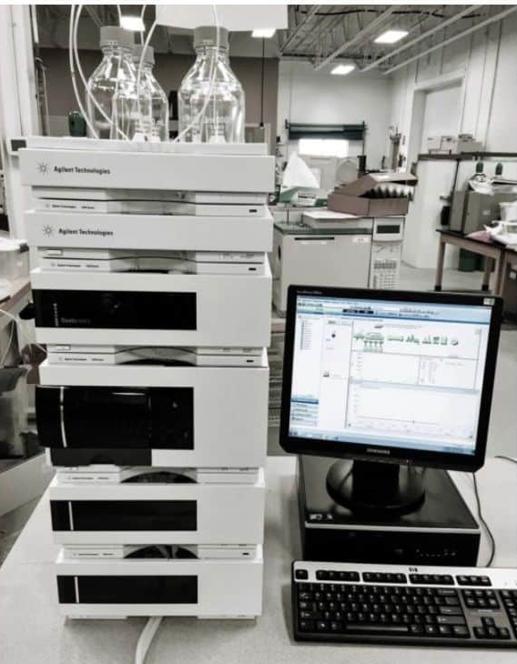
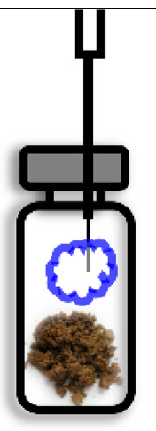
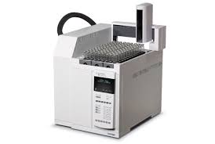
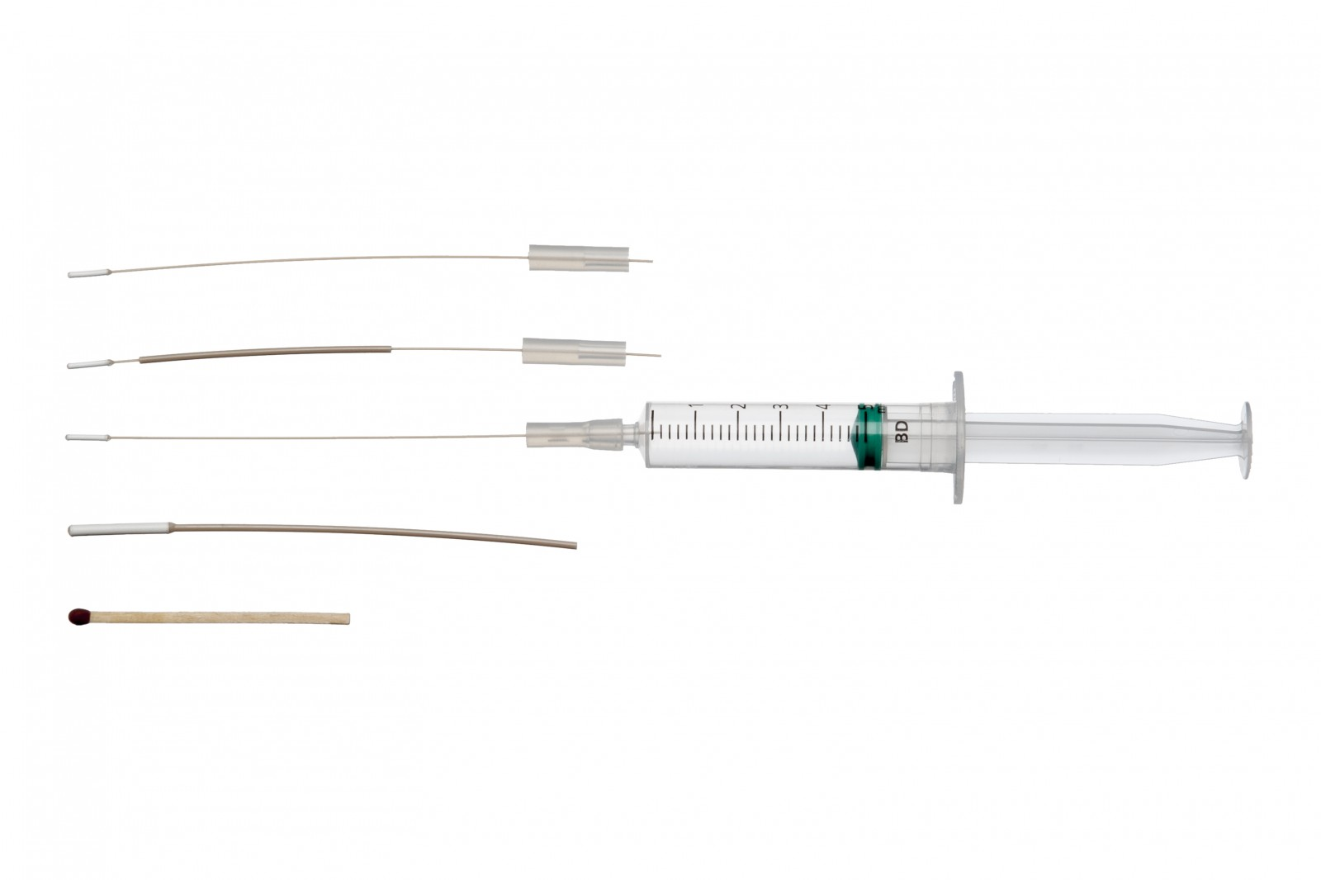
d) Diffusion cell experiments
Phenols: determination and quantification by HPLC-DAD
Mass balance VOCs
VOCs headspace GC-MS
Soil
1 2 4 5 6 7
0 1 2 3 4 5 6 7 8 9 10 11 12

